Slide 1

Bank Churn Analysis
Microsoft Power BI Project
Submitted By: Kartik Ghagre

Slide 2
Topics
About Company
Purpose/ Objective
Stakeholders
Data Gathering
Data Cleaning
Data Transformation
Data Modeling
DAX Calculations
Reports & Visualization- KPI – Actionable Insights
Row-Level Security
Schedule Refresh (Data Gateway)
Dashboard creation
Subscription
Mobile Layout

Slide 3
Company:
Objective:
Equality Bank is the one of the largest private bank in Europe. It provides financial and banking services to their customers.
It offers retail, corporate, international banking with different products and services like savings, credit cards, equities trading, loans, wealth management, investment management.
There are 4000 branches and offices across 65 countries with serving 40 million clients.
To understand the database of the bank customers from year 2016 to 2019 by analyzing their credit history, age, geography etc. , so that customers retention percentage and customer base increases with providing new promotional offers, products and services.
Stakeholders:
Employees
Customers
Product development Team
Data Analytics Team
Software Development Team

Slide 4
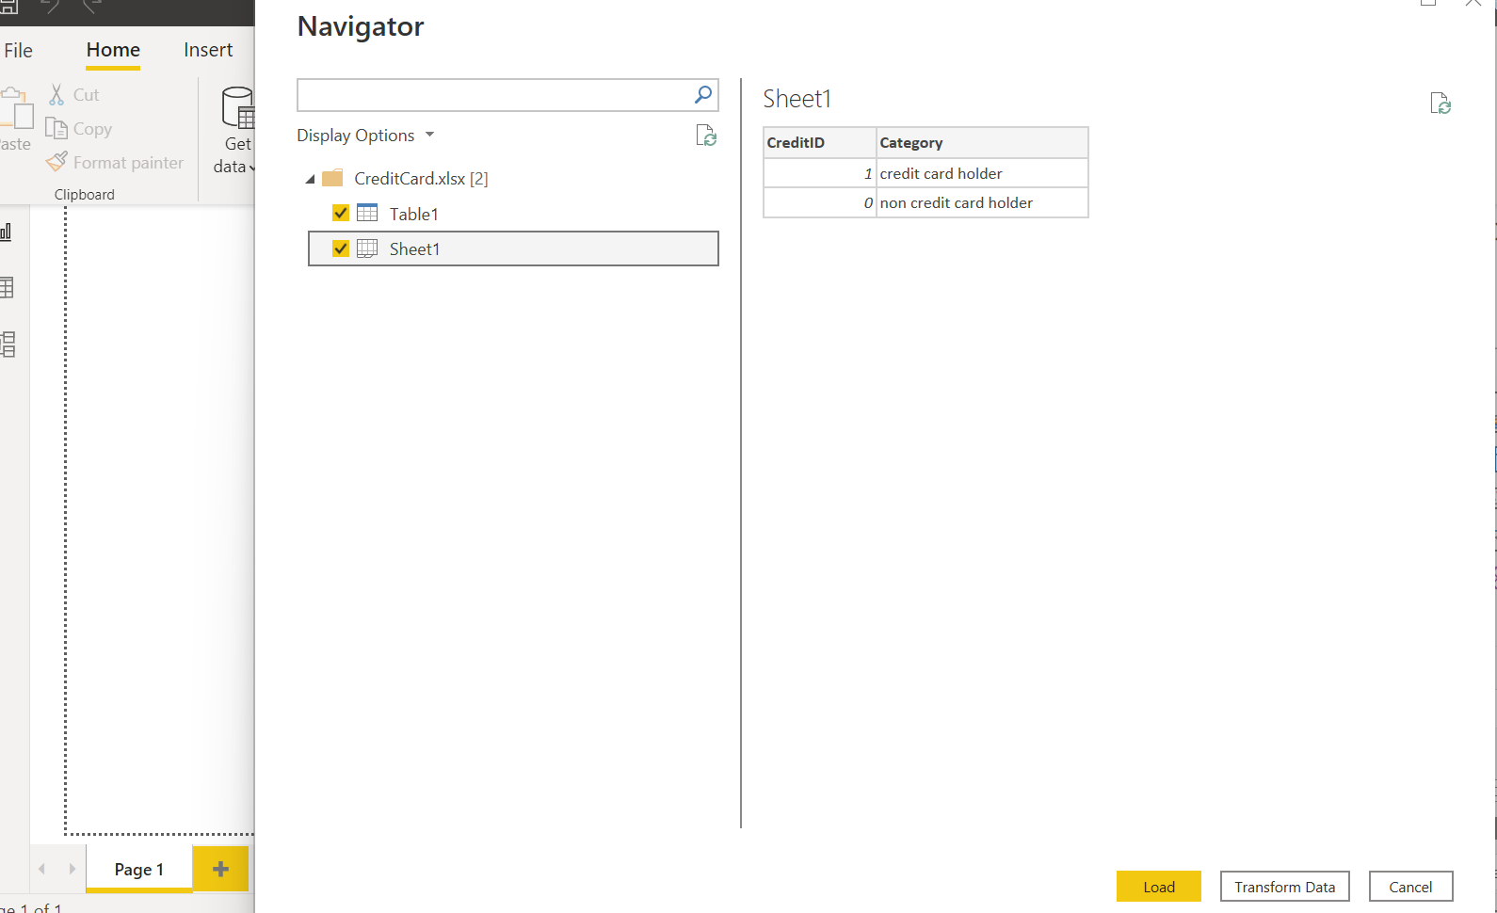
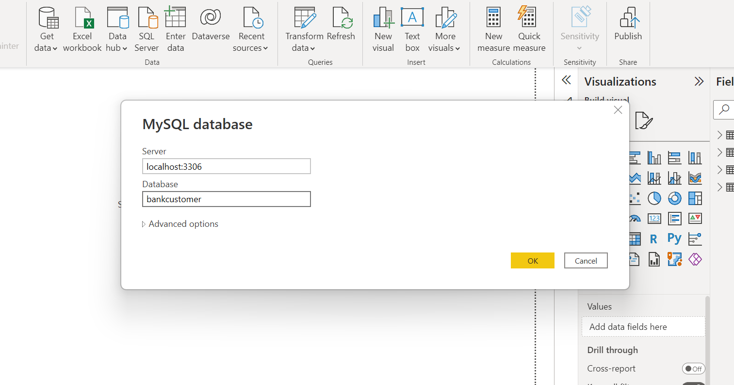
Data Gathering :
Extracted the database from various like Excel and MySQL data sources into the Microsoft Power BI
Made a connection on MySQL workbench and import the data.
Performed data analysis to understand the data by using SQL queries.

Slide 5
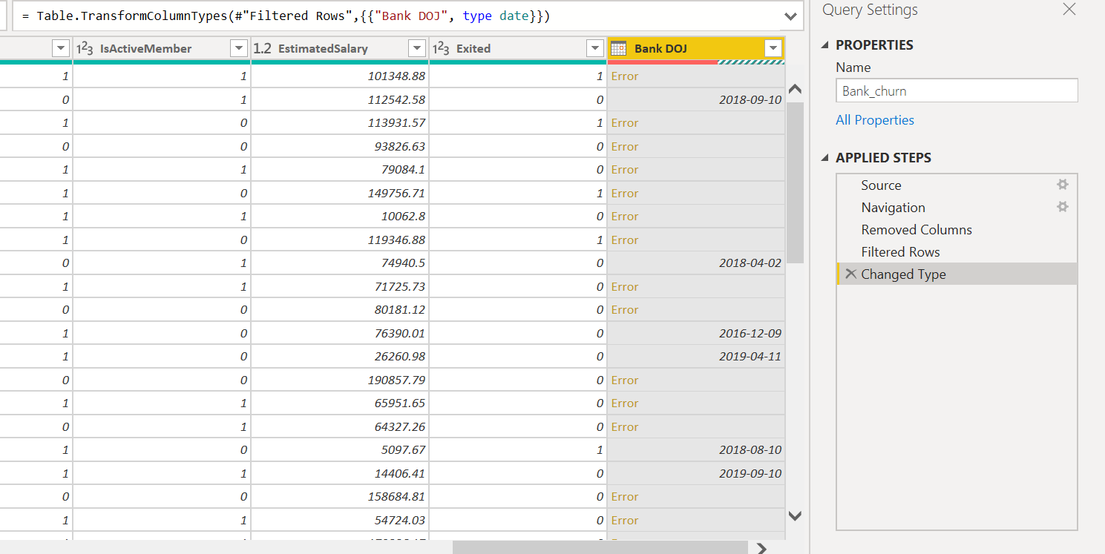
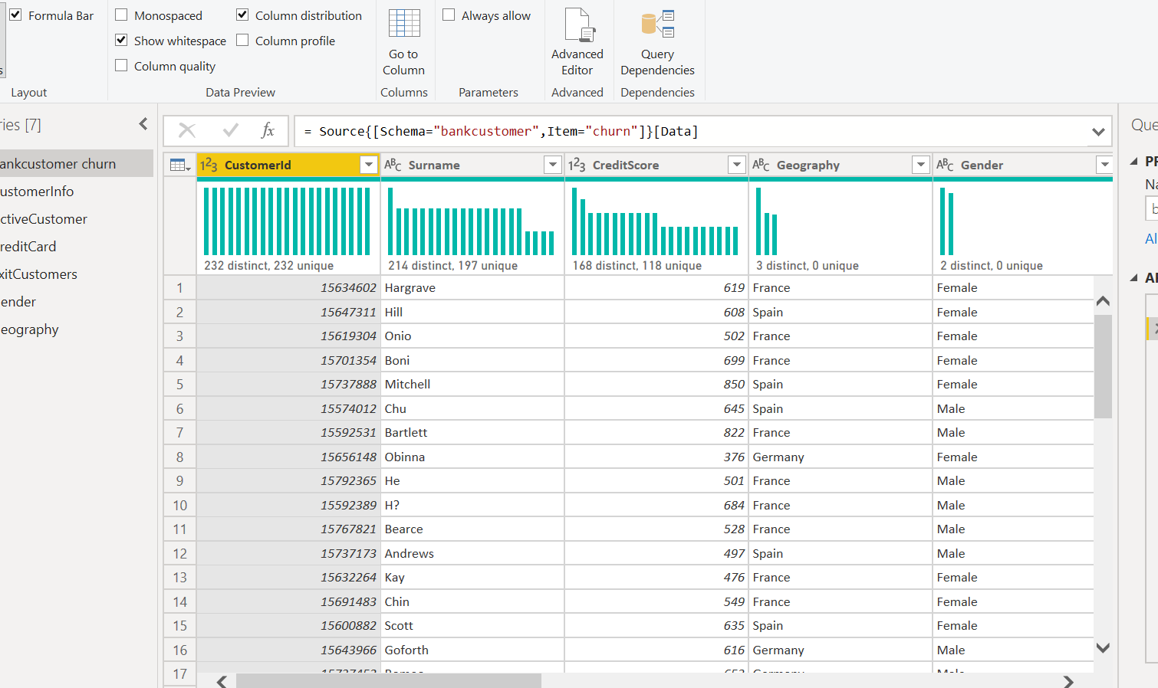
Data Cleaning:
Transform the data into the Power Query editor and understand the data.
Data profiling : Remove errors & duplicates, understanding of Distinct rows.
Changed Data type
Used First row as headers
Major Issues & Solutions :
Issue : In Power Query editor, there was an error in Date data type.
Solution: Went to the options, changes the regional setting into the corrected data type format.
Issue : Unnecessary Information
Solution : Removed the Index column

Slide 6
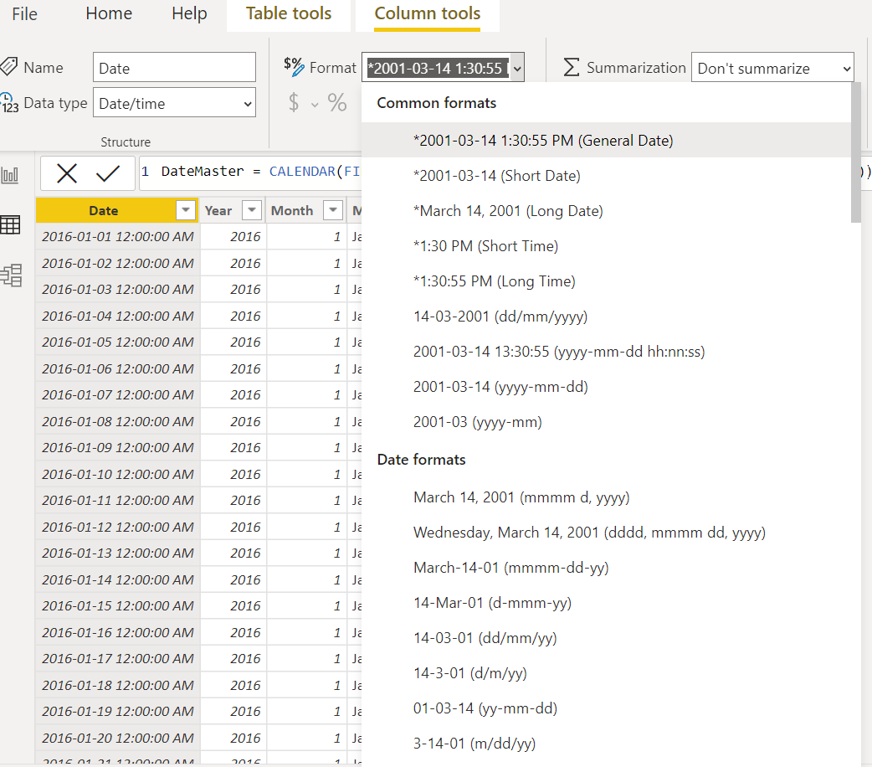
Data Transformation:
Created the DateMaster Table and split out the date, month, year and month name to eliminate the complexity.
DateMaster =CALENDAR(FIRSTDATE(Bank_churn[Bank DOJ]), LASTDATE(Bank_churn[Bank DOJ]))
Year = Year(DateMaster[Date])
Month = MONTH(DateMaster[Date])
Month Name = FORMAT(DateMaster[Date],"MMMM")

Slide 7
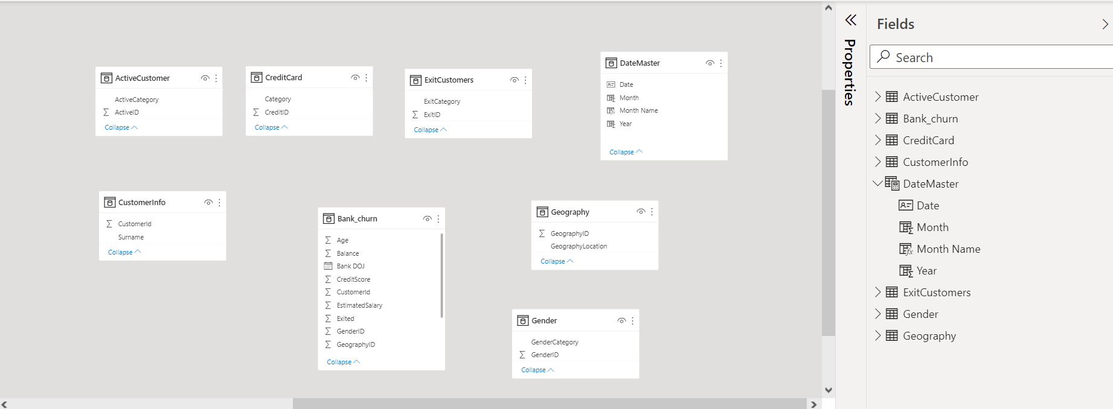
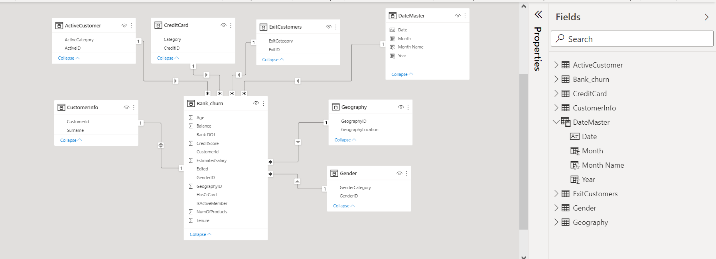
Data Modeling :
In Data model page:
Used star schema (One to many, 1: *) by joining the primary keys to related tables foreign keys.
Fact table : Bank_churn
Lookup tables : Active Customers, Exit customer, DateMaster, Geography, Gender, Customer Info, Credit Card

Slide 8
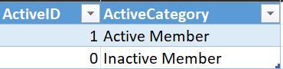
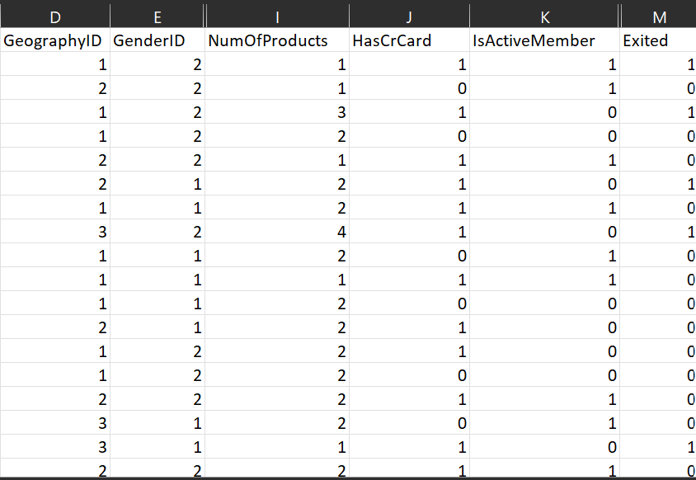
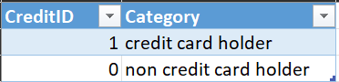
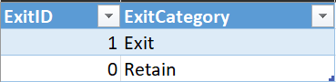
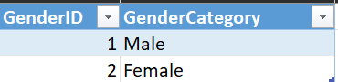
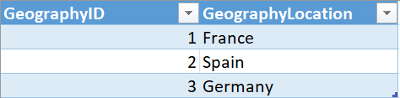
DAX Calculations:

Slide 9
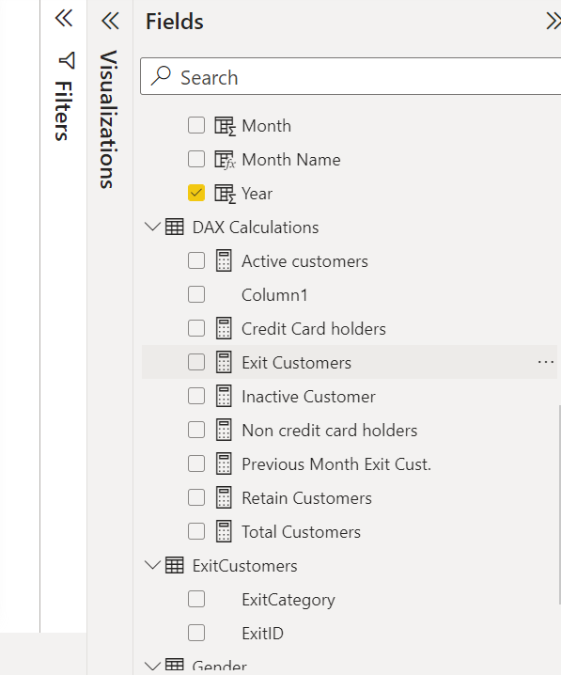
DAX Calculations:
Active customers = CALCULATE(count(Bank_churn[CustomerId]), ActiveCustomer[ActiveCategory]="Active Member")
Total Customers = COUNT(Bank_churn[CustomerId])
Inactive Customer = CALCULATE(COUNT(Bank_churn[CustomerId]), ActiveCustomer[ActiveCategory]="Inactive Member")
Credit Card holders = CALCULATE(COUNT(Bank_churn[IsActiveMember]), CreditCard[Category]="credit card holder")
Non credit card holders = [Total Customers]-[Credit Card holders]
Exit Customers = CALCULATE(count(Bank_churn[CustomerId]), ExitCustomers[ExitCategory]="Exit")
Retain Customers = [Total Customers]-[Exit Customers]

Slide 10
Reporting & Visualization:
Credit score: To understand the customer lies in which credit type.
Excellent : 800-850, Very Good : 740-799, Good: 670-739, Fair : 580-669 and Poor : 300-579
credit Range
= SWITCH(TRUE(),Bank_churn[CreditScore]>=800 && Bank_churn[CreditScore]<= 850, "Excellent",
Bank_churn[CreditScore]>=740 && Bank_churn[CreditScore]<= 799, "very good",
Bank_churn[CreditScore]>=670 && Bank_churn[CreditScore]<= 739, "good",
Bank_churn[CreditScore]>=580 && Bank_churn[CreditScore]<= 669, "Fair",
Bank_churn[CreditScore]>=300 && Bank_churn[CreditScore]<= 579, "poor")
2. Age Bin :
Age Bin
= SWITCH(TRUE(),Bank_churn[Age]>= 18 && Bank_churn[Age]<30, "18-29",
Bank_churn[Age]>= 30 && Bank_churn[Age]<40,"30-39",
Bank_churn[Age]>= 40 && Bank_churn[Age]<50, "40-49",
Bank_churn[Age]>= 50 && Bank_churn[Age]<62,"50-61",
Bank_churn[Age]>= 62 && Bank_churn[Age]<=92,"62-92")
3. Churn Percentage
Churn % =
var exit = [Exit Customers]
var total = [Total Customers]
var ChurnPercentage = DIVIDE(exit,total)
return ChurnPercentage

Slide 11
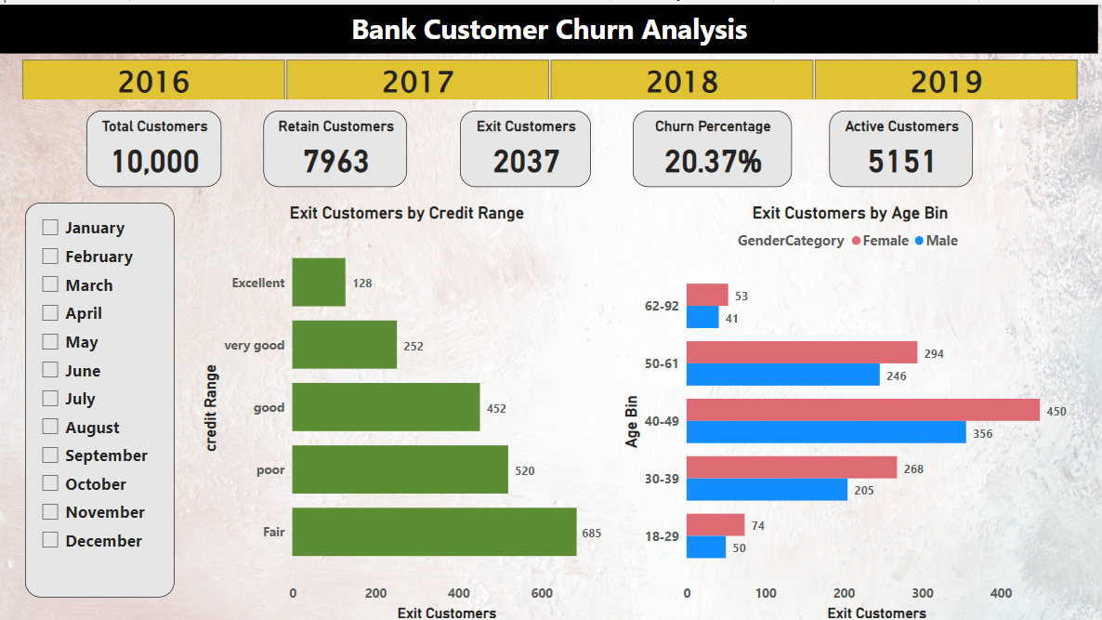
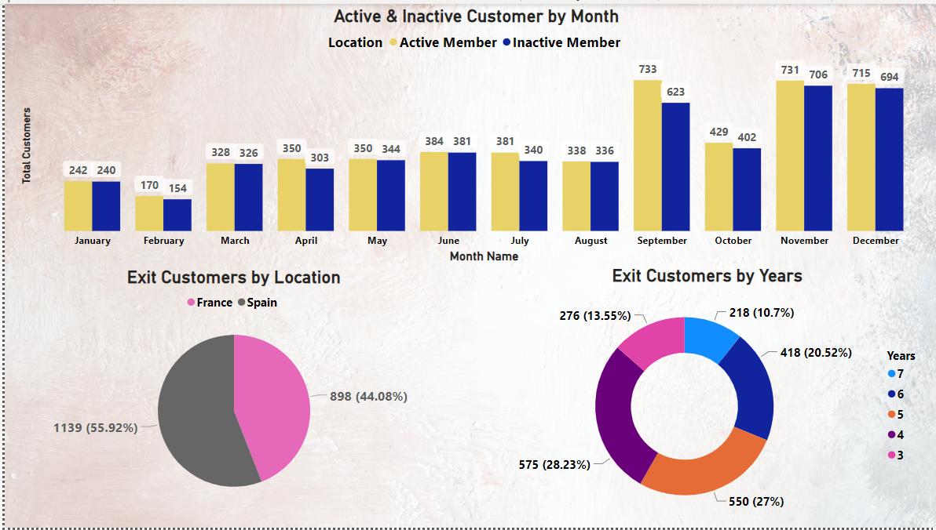
Data Reporting :

Slide 12
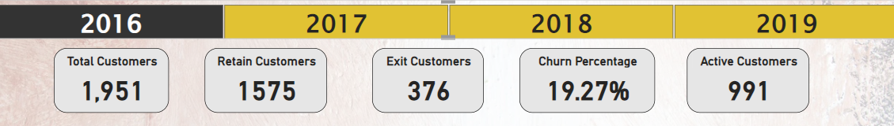
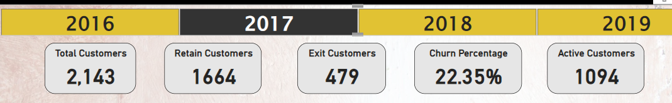
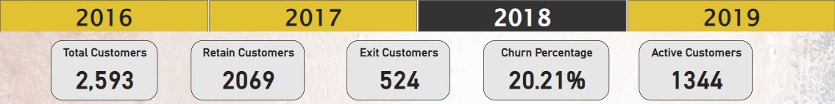
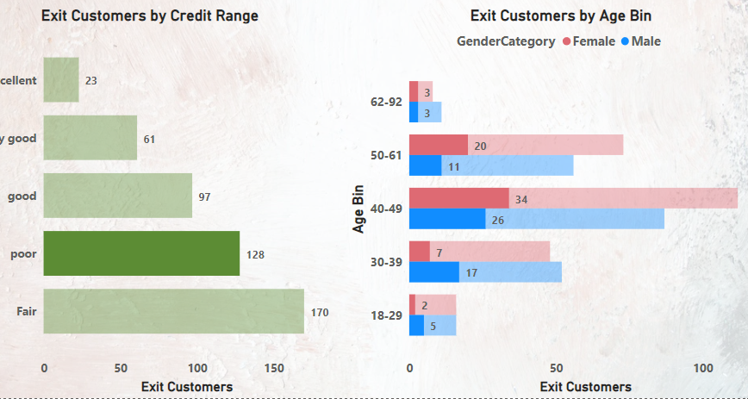
Analysis 1: Churn % increases by 13.7 % from 2016 to 2017 and then decreases with
Problem: Increase in percentage of leaving bank Customers year by year.
Solution: Focusing on Quality of banking products & services rather than increasing the customer base.
Analysis 2: In 2016, exited customer which lies under “Poor” credit range were comes under the age range of 40-49.
Females = 34
Males = 26
Total = 60 Customers
Problem: Majority of chances that active customer lies under 40-49 age leaves the bank because of poor credit score.
Solution: Bank can provide new products or promotional offers to active customers to retain and while using any product increase credit score.

Slide 13
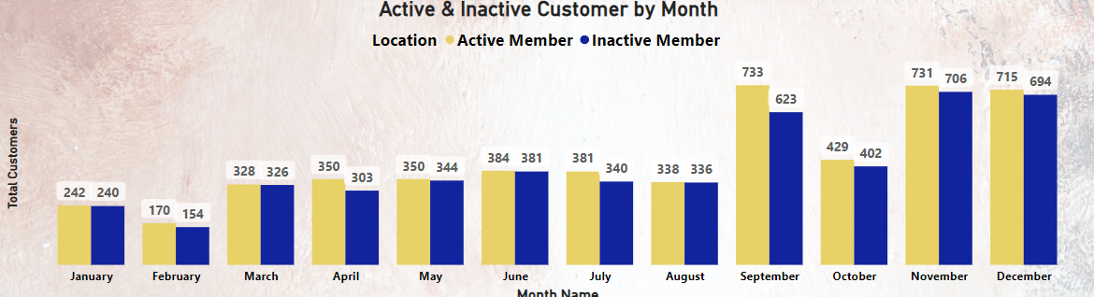
Analysis 3:
Active Customers : Involved in Banking Products.
Inactive Customer: Not involved in Banking Products.
Month-wise Customer base are increasing but in same case active and inactive figures also increasing and both figures are almost same.
Problem: Inactive customers are not involving in bank products and it might chances to get them leave from the bank.
Solution: Launch new products and services related to customer focused so that their activity with financial transactions increases and eventually it increase credit score.
Along with that competitive bank customers take interest in our bank products & services.

Slide 14
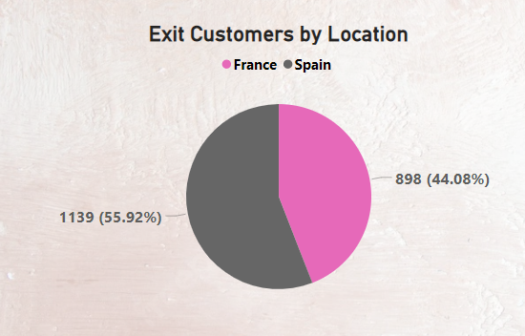
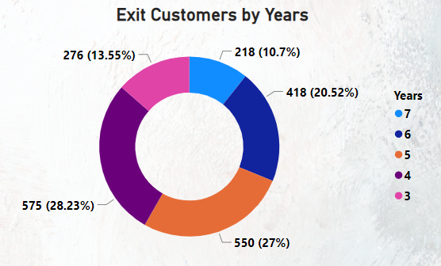
Analysis 4 : Exit customers count by France and spain region from 2016 to 2019
Problem: France customers were not getting those services which the Spain customers were getting. Since France and Spain are sharing their boundaries , so there will not be product gap between 2 countries.
Solution : Product review and analysis of customer interest.
Analysis 5: Count of customers exited after indulge in banking products and services.
Problem : More than 50% of customers left the bank after 3 and 4 years.
Solution : Work required on Customer relation management strategy to retain for long term.

Slide 15
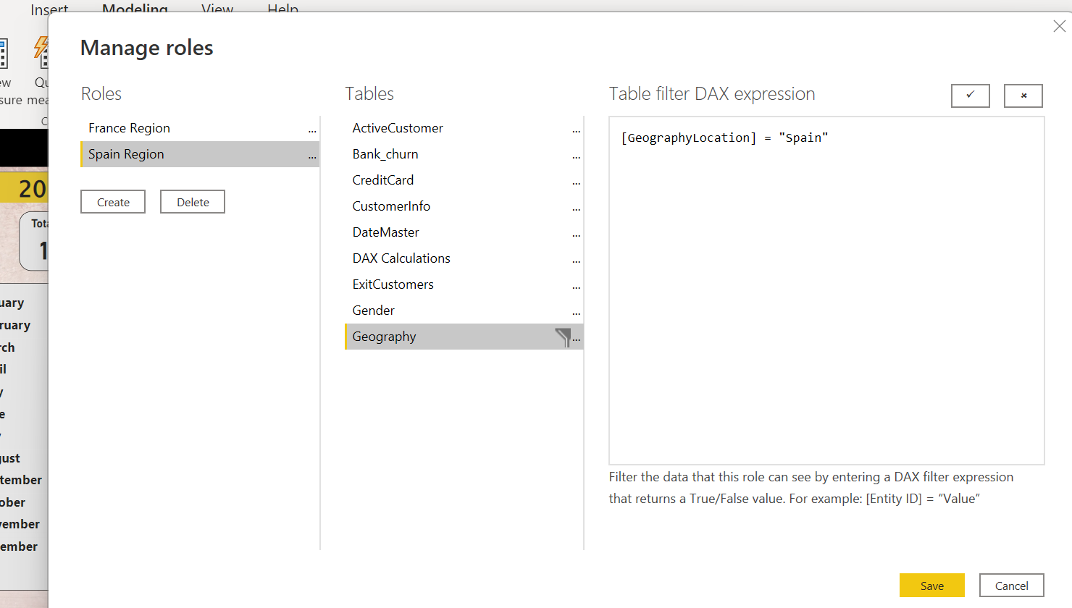
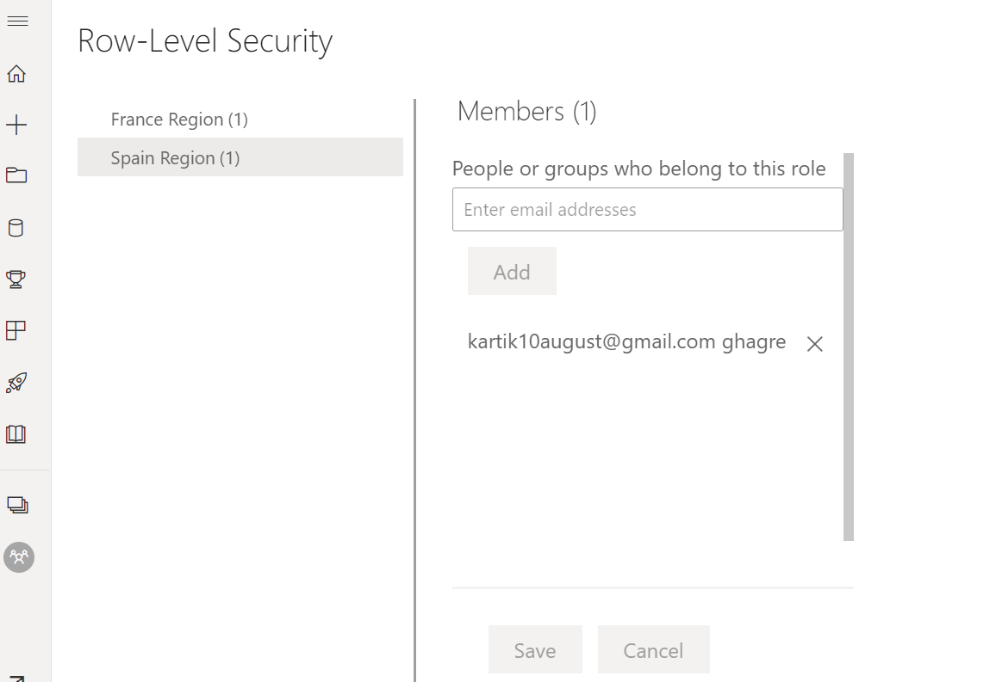
Row-Level security:
Power BI Desktop & Power BI Service

Slide 16
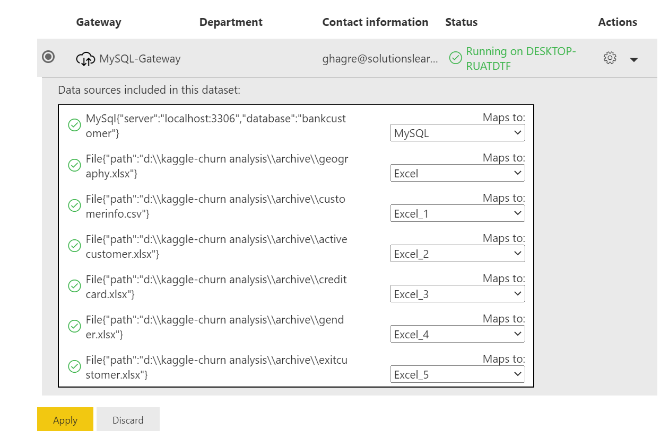
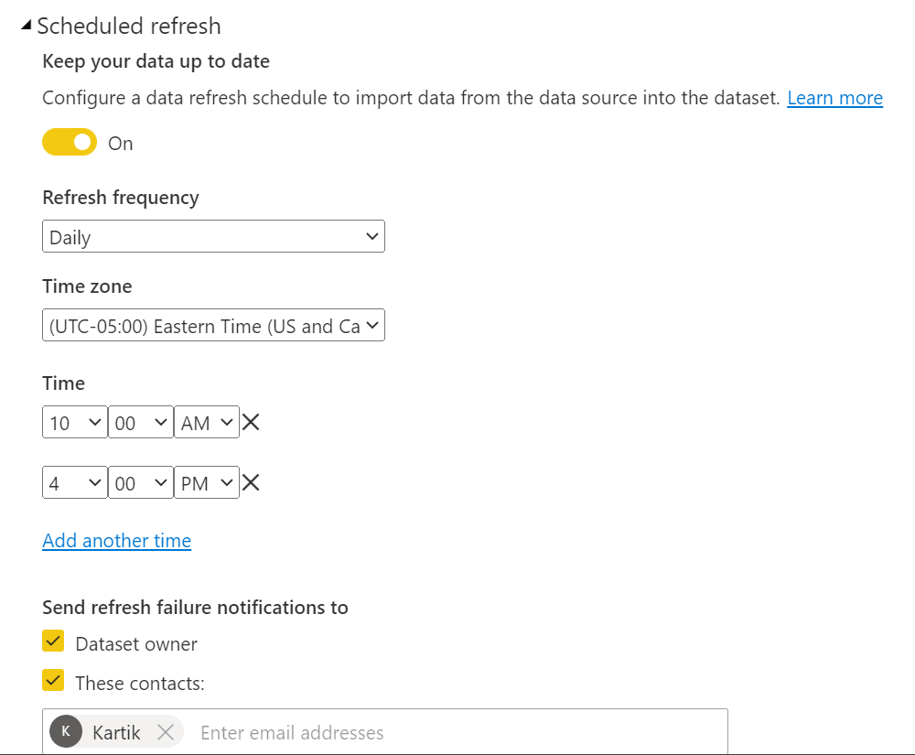
Schedule Refresh :

Slide 17
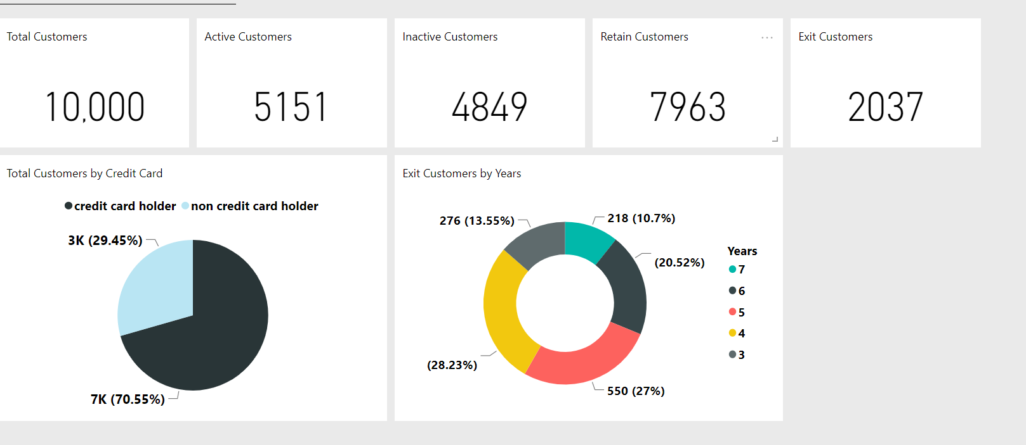
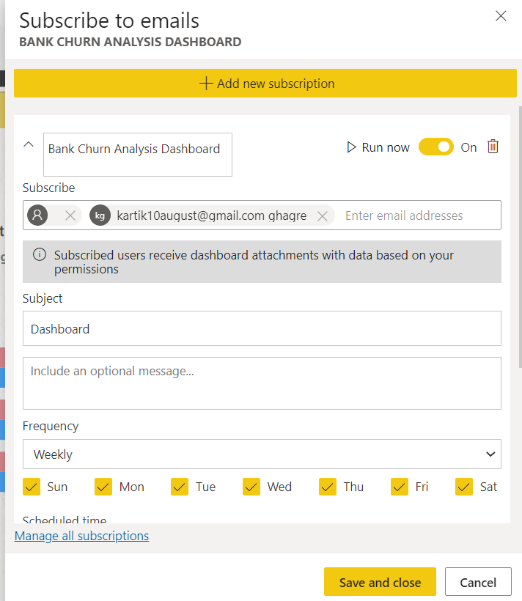
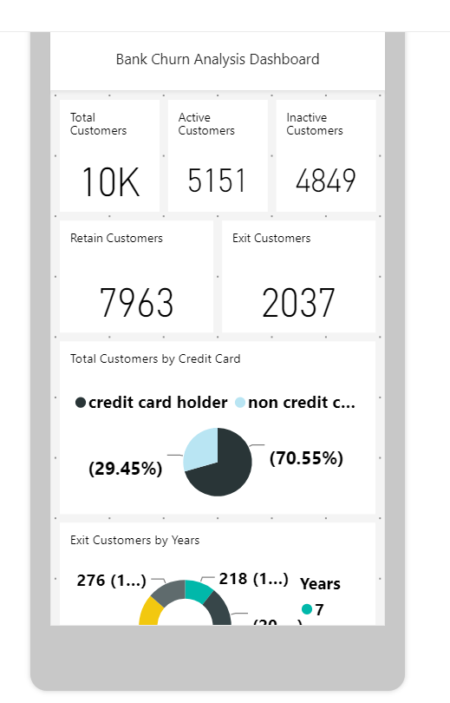
Dashboard, Subscription & Mobile Layout

Slide 18
Thank you References: https://www.kaggle.com/datasets/mathchi/churn-for-bank-customers

